Slide 1
Running head: Compare And Contrast Between Ex-Machina And Avatar
Compare and Contrast Between Ex-Machina and Avatar Movies
Student’s Name
Institutional Affiliation
Date

Slide 2

How the other inspires change or consolidates stability
Instances from both movies indicates the aspect of the other inspiring changes as well as consolidating stability.
In Ex Machina, Ava, who is the other in this perspective inspires the changes in Caleb, who has come specifically to alter and test her viability.
In the Avatar, the Na’vi have inspired what Jake wants to become and thus, despite being an ex soldier, he is determined to become one of them.
Both the movies display futurism.
The movie Avatar displays the aspects of a fiction illusionist world, Pandora, which the Na’vis live.

Slide 3
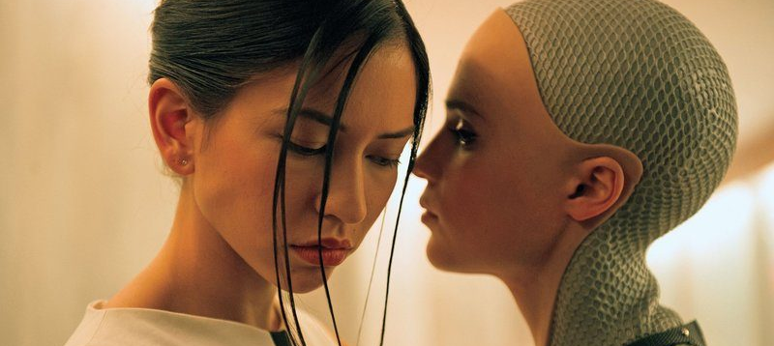
The relationship between the other and the dominant group (humans/society)
The dominant group in both the movies is represented by the people in society that have not been manipulated.
The Na’vi in Avatar, represented by what Jake wants to become as well as the transhumanists that Nathan is developing represented by Ava in the movie Ex Machina display different physique than the other dominants groups.
The “other groups are technologically manipulated and thus presented extreme capabilities than he dominant groups.

Slide 4

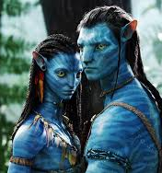
The role of art challenging or affirming the narrative of ‘the other’ within its context
Art has taken the center of representation in the two movies.
Avatar represents art that the ‘other’ can live in Pandora, where the other dominant people do not live.
Ex Machina, represents a people that can perform specific orders, like Nathan calls Ava his Artificial Intelligence and he is finally falling in love with her.
Caleb himself has reached a point where he doubts whether he might be one of them and decides to cut himself and hurts his hands bleeding profusely.

Slide 5
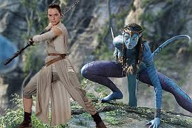
How the similar or contrasting relationships of ‘the other’ in your text reflect contextual values, attitudes and beliefs
The characteristics of the ‘other’ from the two texts have brought about different values, attitudes as well as beliefs.
The ‘other in both movies is believed to contain extra power, capabilities as well as ability.
The transhumanist nature of the ‘other’ in both movies is changing the perspective of many and bringing about changes in the insights of the dominant groups.
The ‘other’ in Avatar is seen to be extraordinary making Jake want to become like them.
The belief about the perspectives of the ‘other’ in Ex Machina is what is driving Nathan to continue working on Ava and the house keeper who too is a transhumanist.

Slide 6
References
Elsaesser, T. (2011). James Cameron's Avatar: access for all. New Review of Film and Television Studies, 9(3), 247-264.
Garland, A. (2015). Ex machina. Faber & Faber.
Jones, N. (2016). Ex Machina by Alex Garland. Science Fiction Film and Television, 9(2), 299-303.

